Slide 1
Box Model
Sizing your elements

Slide 2
Height and Width
The default width of inline elements is the content
Elements that are not inline can take width and height properties – we saw this in the Display lecture.

Slide 3
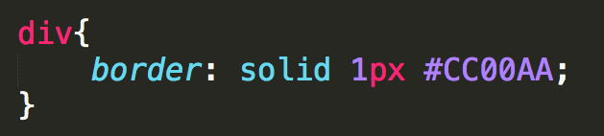
Border
Any element can have a border around it
border property specifies style, width, and color
The border style MUST be specified

Slide 4
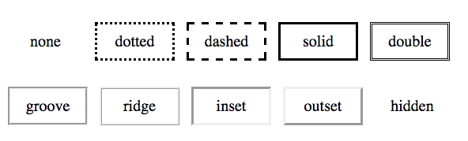
Border-style
none, dotted, dashed, solid, double, groove, ridge, inset, outset, hidden

Slide 5
Border width and color
Width
Set in pixels or thin, medium, or large
Color
Name - “blue”
RGB – rgb(0,0,255)
hex - #0000FF
transparent

Slide 6







Specifying Individual Sides

Slide 7
Margin
Margin is additional space outside your border – between you and neighbor
Positive margin
element moves right/down
Negative margin
element moves left/upward

Slide 8
Padding
Padding is additional space between the element and its border.
Positive padding
border moves outward from element
Negative padding
border moves over the element

Slide 9
Margin and Padding
Neither takes a color (transparent)
Can also be defined in 1 - 4 values like border

Slide 10
padding
The empty space between the start of the element and the start of the text
margin
The space between the edge of the screen and the element
Here is my text

Slide 11
Additive Height and Width
Here is my text
Here is my text
margin
+ border
+ padding
+ width
= actual width

Slide 12
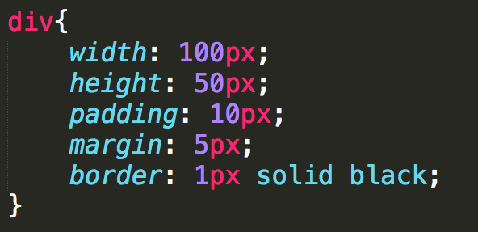
What is the width and height?
width = 132px:
height = 82:

Slide 13
Centering an Element
To horizontally center an element use:
margin: 0 auto;
But…
The element must display: block
The element must not float
The element must not have a fixed or absolute position
The element must have a width that is not auto

Slide 14
box-sizing
box-sizing takes some of the “math” out
Options:
content-box: default additive
border-box: width takes content, padding, and border into consideration

Slide 15
Measurements
Absolute – set to a specific size
px, mm, cm, pt, ….
Fluid – sets size relative to surrounding elements
%, vw, vh
em (for font): 1em is current size, .75 is 75% of the current size
rem (for font): 1rem is current size of root element

Slide 16
Example

Slide 17
Review
Design sketches should be done with box model (margin, border, padding, content) in mind.
Use box-model to reduce complexity
Margin must always be considered
Use fluid sizes for best viewing

Slide 18

Acknowledgements/Contributions
These slides are Copyright 2015- Colleen van Lent as part of http://www.intro-webdesign.com/ and made available under a Creative Commons Attribution Non-Commercial 4.0 License. Please maintain this last slide in all copies of the document to comply with the attribution requirements of the license. If you make a change, feel free to add your name and organization to the list of contributors on this page as you republish the materials.
Initial Development: Colleen van Lent , University of Michigan School of Information

